Slide 1
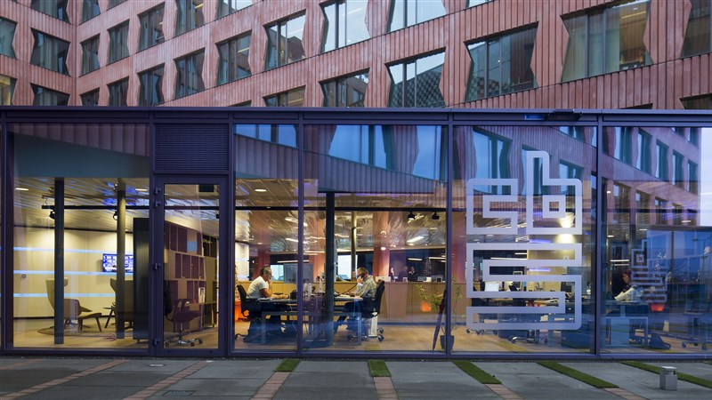
CBS Chatbot
Jan, Askin, Şeyma, Timo

Slide 2
Table of contents
Findings
Upcoming Week

Slide 3
Findings
Topic models
Multiclass classification
02
LDA en NMF model
01
One vs all
Naïve Bayes type

Slide 4
LDA en NMF model
Topic Analyses
Predetermined amount of topics
Positive dataset

Slide 5
Examples NMF
'inkomensgroepen', 'persoonlijk', 'netto', 'vraag', 'antwoord', 'goedemorgen', 'statline', 'kans', 'goedemiddag', 'jullie'
'10', 'besteedbaar', 'zoek', 'inkomen', 'bruto', 'gemiddelde', 'regio', 'gemiddeld', 'informatie', 'mediaan'
'verdieners', '35', '18', 'leeftijd', 'kinderen', 'gezinnen', 'aantal', 'gelderland', '65', 'jaar'
'verdienen', '20', 'euro', '80', 'hoeveel', '37', '60', '10', '67', '000'

Slide 6
Multiclass Classification
Defined different types of questions
Labeled the list of sentences from every category
Ran through Different Models

Slide 7
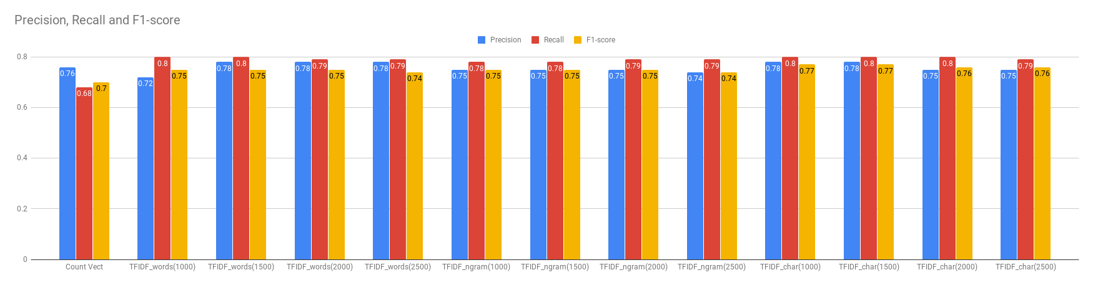
Results

Slide 8
Upcoming Week
Research paper
01
Improve Multiclass classification
02
Experiment with multi-class as main model
03

Slide 9

Questions or feedback?

